Slide 1
CA I – November 15 Assignment
Week 11 Vocabulary
Be MAD EXCITED! WOOT! WOOT!

Slide 2
Directions
Open the Week 11 Vocabulary from the website
Each slide needs to include the following
The root word(s)
The meaning of the root word(s)
A complete sentence using one of the examples for that root word
A picture (and source! Include the url!) that represents the root word(s)
3. Choose two root words from Week 10, two root words from Week 9, and two root words from Week 8 (all lists are on the website) and complete the above steps for those root words

Slide 3
Directions Continued
4. Save your assignment as yournamevocabpp
5. Email your assignment to Mrs. Hallmark
ahallmark@joplin.k12.mo.us

Slide 4
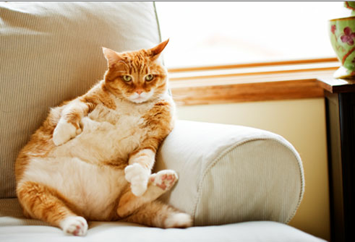
Example
am, amic
Meaning(s): love, friend
Example sentence: My cat, Simon, is quite amiable.
http://img.webmd.com/dtmcms/live/webmd/consumer_assets/site_images/articles/health_tools/pet_treats_slideshow/getty_rm_photo_of_extremely_fat_cat_on_sofa.jpg

Slide 5
And, finally…
…be good.
…stay on-task.
…get this assignment finished!

